Slide 1
BUDT 758F – Final Presentation
Team 5: Aanchal Kanodia, Sahil Bareja, Gauri Bhide, Pallavi Kambiri, and Zhe Du

Slide 2


Campaign Overview: Goals & Strategies
Two main campaigns: Brand awareness (Taiga & TaigaTribe) and Leads (#Taiga sign-ups)
Metrics goals (pre-campaign):
What we achieved overall:

Slide 3
Campaign Overview: Strategies
Keywords: Meetings with Taiga CEO, Behavior & Acquisition reports from GA, AdWord Keyword Planner
Location targeting
Leveraged Display Networks

Slide 4
Campaign Overview: Operational Details
Campaign dates: 20th April - 2nd May (~ 11 days)
Money spent: ~ $249
Campaign structure:
Taiga Brand Awareness: Services offered - Agile, Services offered - Task Board, Services offered - PM
Taiga Leads - Sign-ups

Slide 5
Campaign Overview: Operational Details
Basic Schedule:
Ran daily (except for period between 23rd Apr - 25th Apr; we re-structured the campaign in these days)
Campaign time was limited by daily budget: Initially $30, post 25th April $40 ($30 - Taiga Brand Awareness, $10 - Taiga Leads)
Manual CPC bidding: $1.5 - $4 for keywords (depending on campaign). Used suggestions for top-of-page bid if it was within 50 cents.

Slide 6
Evolution of Campaign Strategy
Altering strategy to reduce bad traffic by:
Changing keyword type from broad match to phrase match
Proactively adding negative keywords bringing bad traffic to the website
Leveraging display network by monitoring and excluding irrelevant URLs
Increasing the maximum CPC for higher ad positioning
Diving our campaigns into several relevant AdGroups
Halted the TaigaTribe campaign

Slide 7
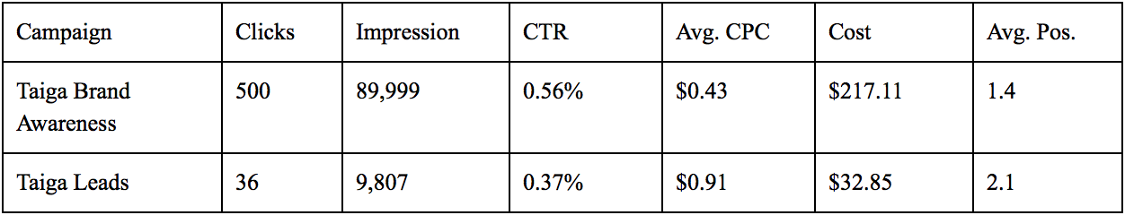
Key Results
Performance Overview - Campaigns

Slide 8
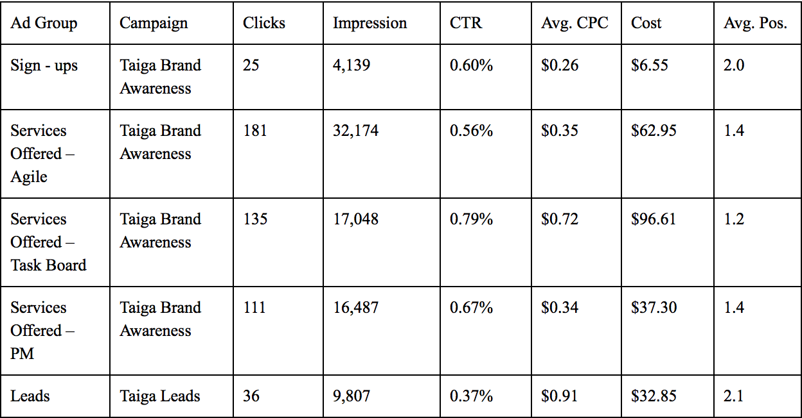
Key Results
Performance Overview - Ad Groups

Slide 9
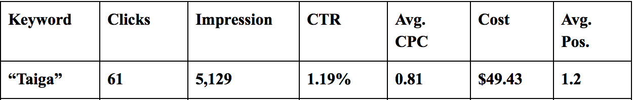
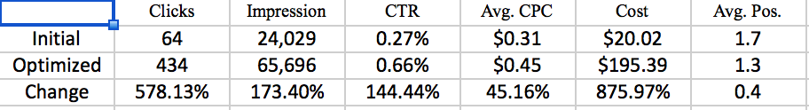
Key Results
Most Effective Keyword
Initial Results Vs. Optimized Results

Slide 10
Conclusion
We did well ! Reached near our metrics.
Had a few hiccups, but carved our way out of those and made modifications to our campaign accordingly.
Learnt a lot about Digital Marketing.
Thank you !

